Slide 1

Chapter 15
Webpage Optimization

Slide 2
Learning Objectives
How to test your web-page performance
How browser and server interactions impact performance
What impact image file size and resolution have on download times
How to reduce JavaScript download overhead by obfuscating your code
How using multiple servers for different resource types may load-balance resource requests
How to improve download performance for text-based content by directing the server to compress the content using gzip

Slide 3
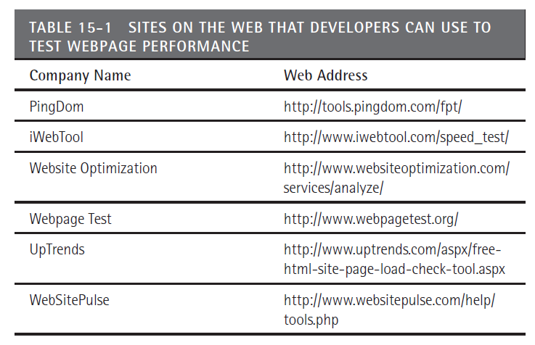
Sites to test your Web site’s performance

Slide 4
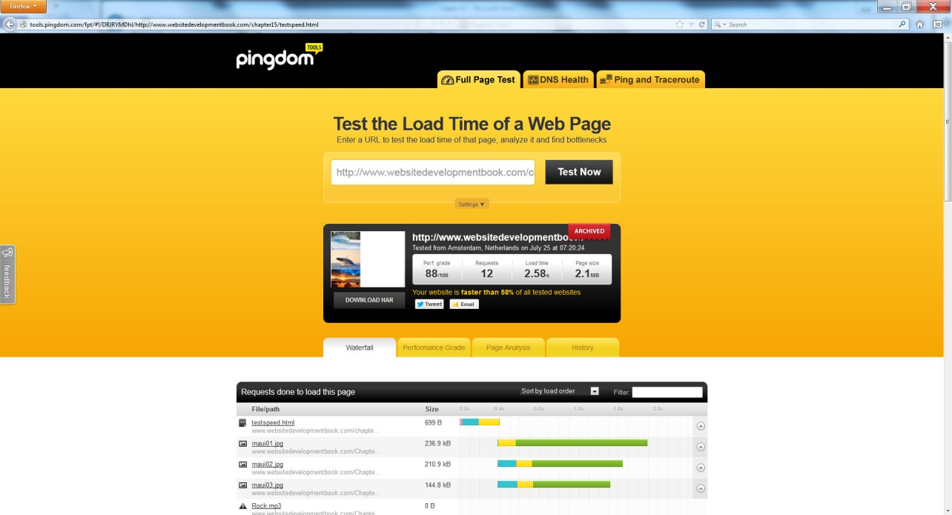
Demo web page
<!DOCTYPE html> <html> <body> <img src="http://www.WebSiteDevelopmentBook.com/Chapter02/maui01.jpg"/><br/> <img src="http://www.WebSiteDevelopmentBook.com/Chapter02/maui02.jpg"/><br/> <img src="http://www.WebSiteDevelopmentBook.com/Chapter02/maui03.jpg"/><br/> <audio controls="controls"> <source src="http://www.WebsiteDevelopmentBook.com/Chapter18/Rock.mp3" type="audio/mp3"/> <source src="http://www.WebsiteDevelopmentBook.com/Chapter18/Rock.ogg" type="audio/ogg"/> </audio><br/> <video autoplay="autoplay" controls="controls"> <source src="http://www.WebsiteDevelopmentBook.com/Chapter18/Cigar.mp4" type="video/mp4"/> <source src="http://www.WebsiteDevelopmentBook.com/Chapter18/Cigar.ogg" type="video/ogg"/> <source src="http://www.WebsiteDevelopmentBook.com/Chapter18/Cigar.flv" type="video/flv"/> <source src="http://www.WebsiteDevelopmentBook.com/Chapter18/Cigar.webm" type="video/webm"/> <source src="http://www.WebsiteDevelopmentBook.com/Chapter18/Cigar.mov" type="video/mov"/> Video Tag Not Supported </video> </body> </html>

Slide 5
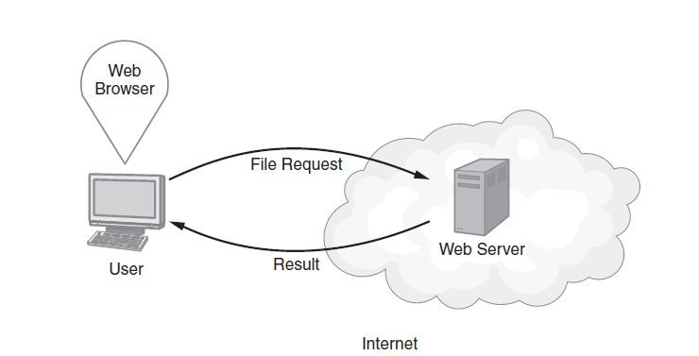
Revisiting browser/server interactions

Slide 6
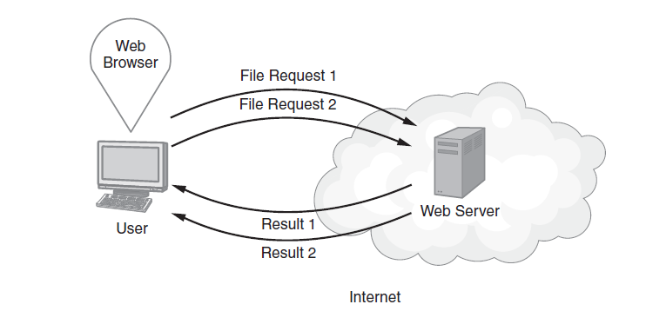
Some browsers support parallel download operations

Slide 7
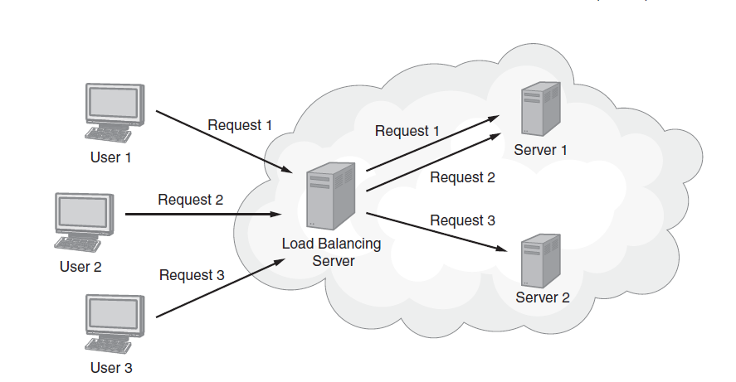
Load balancing

Slide 8
Reduce Your Image Resolution
Do not simply use the <img> tag width and height
Use a program such as PhotoShop to reduce the resolution to 72 DPI and the size to the height and width you need

Slide 9
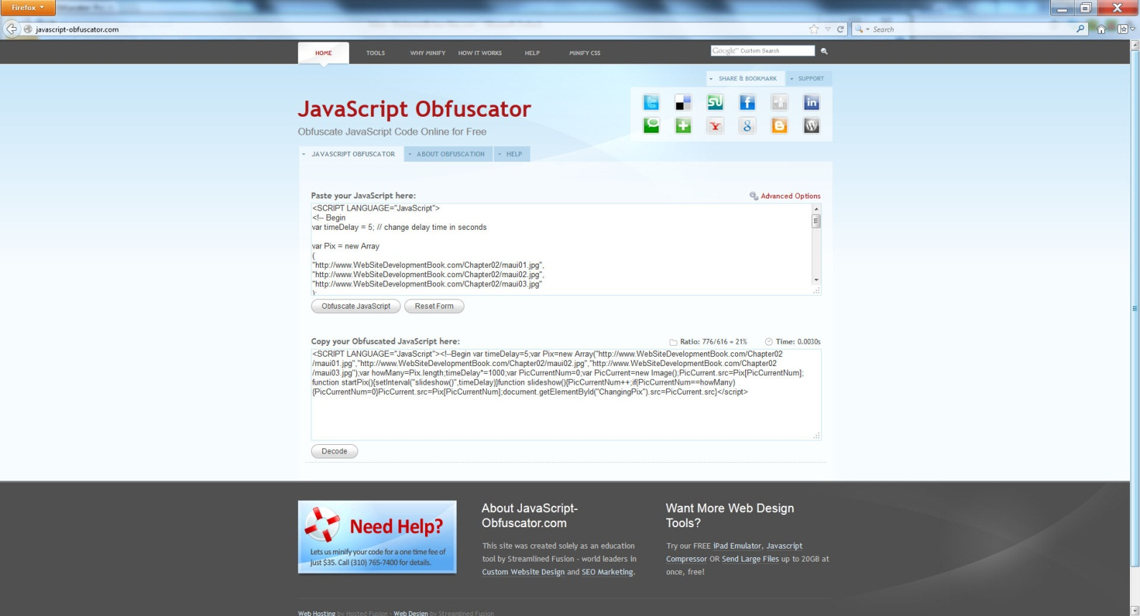
Reduce javascript (http://javascript-obfuscator.com/)

Slide 10
Sample obfuscation
<SCRIPT LANGUAGE="JavaScript"><!--Begin vartimeDelay=5;var Pix=new Array("http://www.WebSiteDevelopmentBook.com/Chapter02/maui01.jpg","http://www.WebSiteDevelopmentBook.com/Chapter02/maui02.jpg","http://www.WebSiteDevelopmentBook.com/Chapter02/maui03.jpg");var howMany=Pix.length;timeDelay*=1000;var PicCurrentNum=0;var PicCurrent=new Image();PicCurrent.src=Pix[PicCurrentNum];function startPix(){setInterval("slideshow()",timeDelay)}function slideshow(){PicCurrentNum++;if(PicCurrentNum==howMany){PicCurrentNum=0}PicCurrent.src=Pix[PicCurrentNum];document.getElementById("ChangingPix").src=PicCurrent.src}</script>

Slide 11
Move JavaScript Code to the Bottom of Your Page
Some browsers will block downloads until JavaScript is processed

Slide 12
Consider Multiple Servers
<body> <img src="http://www.class-files.com/WebSiteDevelopmentBook.com/Chapter02/maui01.jpg"/><br/> <img src="http://www.class-files.com/WebSiteDevelopmentBook.com/Chapter02/maui02.jpg"/><br/> <img src="http://www.class-files.com/WebSiteDevelopmentBook.com/Chapter02/maui03.jpg"/><br/> <audio controls="controls"> <source src="http://www.CloudBookContent.com/WebsiteDevelopmentBook.com/Chapter18/Rock.mp3" type="audio/mp3"/> <source src="http://www.CloudBookContent.com/WebsiteDevelopmentBook.com/Chapter18/Rock.ogg" type="audio/ogg"/> </audio><br/> <video autoplay="autoplay" controls="controls"> <source src="http://www.WebsiteDevelopmentBook.com/Chapter18/Cigar.mp4" type="video/mp4"/> <source src="http://www.WebsiteDevelopmentBook.com/Chapter18/Cigar.ogg" type="video/ogg"/> <source src="http://www.WebsiteDevelopmentBook.com/Chapter18/Cigar.flv" type="video/flv"/> <source src="http://www.WebsiteDevelopmentBook.com/Chapter18/Cigar.webm" type="video/webm"/> <source src="http://www.WebsiteDevelopmentBook.com/Chapter18/Cigar.mov" type="video/mov"/> Video Tag Not Supported </video> </body> </html>

Slide 13
Consider a Content-Delivery Network
Depending on the location of your server as well as the location of the user browsing your site, your page’s download time will differ.
For a user across the world, for example, the content must travel through many more network hops than it would for a user down the street.
To reduce such network overhead, many sites use content-delivery networks, which are collections of servers distributed either across the country or around the globe, depending on your needs.
The content-delivery networks are high-performance servers that can deliver content quickly. To use such a server, you would acquire space, upload your content, and then refer to the server within your HTML page.

Slide 14
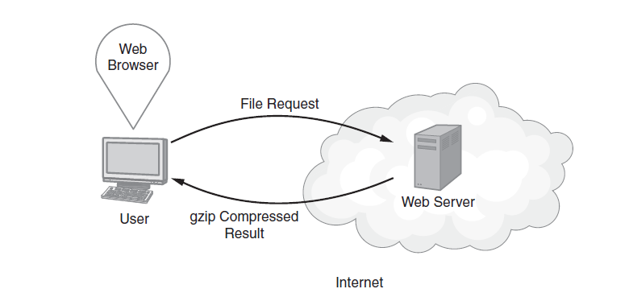
Compressing Text-Based Content

Slide 15
Reducing JavaScript and External CSS File References
As you have learned, when your site uses JavaScript or CSS, you can use one or more external file references to integrate content into your HTML file. If you can combine multiple files into one, you may improve the download performance.

Slide 16
Move CSS Definitions to the Top of Your Page
As your browser downloads your HTML content, the browser will use CSS style definitions to begin to render the page. To improve page-loading performance, you should place your CSS definitions at the top of your page. Otherwise, to avoid having to re-render content, the browser may stop the rendering process until it has encountered all of your CSS definitions.

Slide 17
Avoid Redirects
When Web developers release new sites, they will often place a redirect within the page of an old site that directs the browser to automatically move the user to the new site. Although such redirects are convenient for the developers, they introduce a level of additional HTTP requests that add overhead to the downloading process. As such, you should try to avoid or at least reduce such redirects within your pages.

Slide 18
Controlling browser caching
As you know, after you download an HTML page and the corresponding resource files, such as images, your browser will normally cache the contents in a temporary storage location on your disk. If you later return to the site, your browser can use the cached content as opposed to downloading the files from the Web server. The browser can retrieve the cached-page content much more quickly, which improves the user’s experience.
Behind the scenes, the browser examines each page’s cache settings. Developers will sometimes disable caching to insure the user must always retrieve the most recent content from the server. Other developers will direct the browser to check whether or not the server has a more current version of the content, and if so, to download it. Unfortunately, checking for updated content also takes time and adds overhead.
If your page has static content that will not change, you can use a metadata tag to set your page’s expiration date to a date far into the future. If a page has expired, the browser will request new content from the server. If the page is not expired, the browser can use the cached content.

Slide 19
Sample cache control
<!DOCTYPE html> <head> <META HTTP-EQUIV="EXPIRES" CONTENT="Fri, 31 Dec 2031 11:59:59 GMT"> </head> <html> <body> <img src="http://www.WebSiteDevelopmentBook.com/Chapter02/maui01.jpg"/><br/> <img src="http://www.WebSiteDevelopmentBook.com/Chapter02/maui02.jpg"/><br/> <img src="http://www.WebSiteDevelopmentBook.com/Chapter02/maui03.jpg"/><br/> </body> </html>

Slide 20
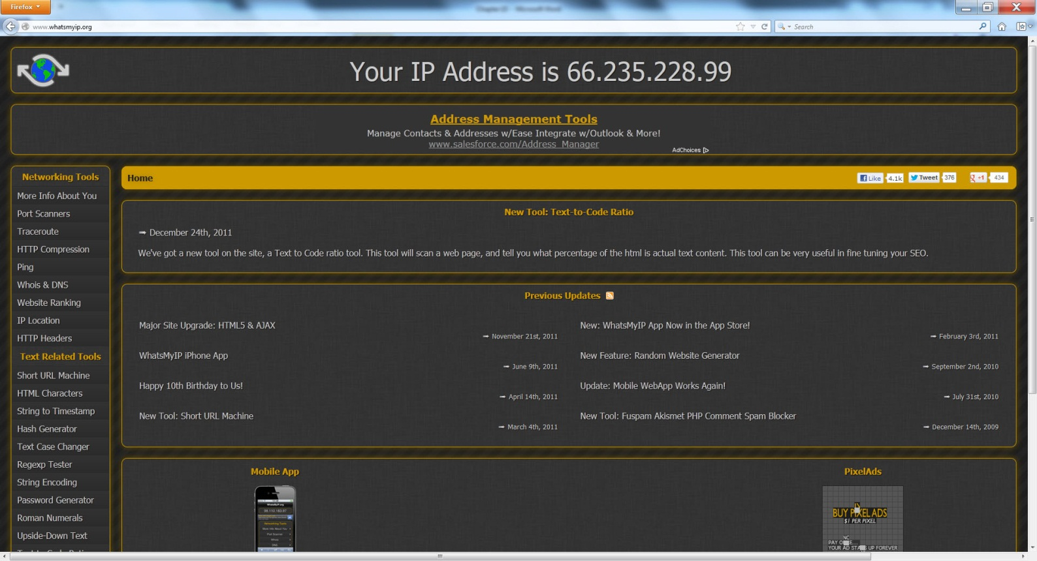
Real world: what’s my IP?

Slide 21
summary
As users move from site to site across the Web, they have expectations with respect to each site’s performance. As a general rule, your site should download in less than 2.5 seconds. If users have to wait beyond a few seconds for your page, many will move on to other sources of content. As you design your webpages, you need to keep performance in mind. Across the Web, there are several sites you can use to test your page performance.
Ways you can improve your site’s performance include:
Moving images, videos, and audios from your home page to a secondary page.
Reducing image size and resolution.
Load-balancing server requests by using multiple servers for different content types.
Directing your server to use gzip compress for text-based content.
Setting the cache expiration date to a date far in the future for static content.

